Slide 1
HOSPITAL MANAGEMENT SYSTEM
SQL PROJECT
by Shreyas

Slide 2
INTRODUCTION
Hospital Management System is designed to manage various aspects of hospital operations efficiently.
It serves as a centralized platform for handling activities.

Slide 3
OBJECTIVE
Hospital Management System optimize the operations of healthcare facilities, ensuring efficient delivery of services.
Efficient Patient Care
Data Management
Financial Management
Improved Decision Making

Slide 4
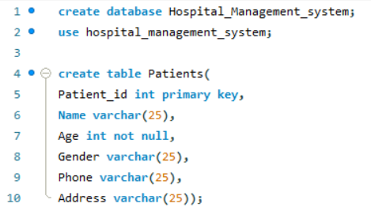
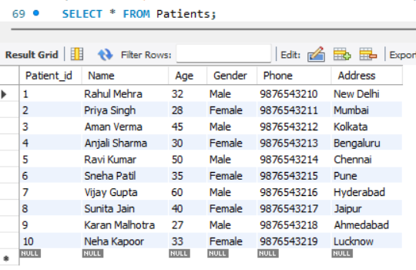
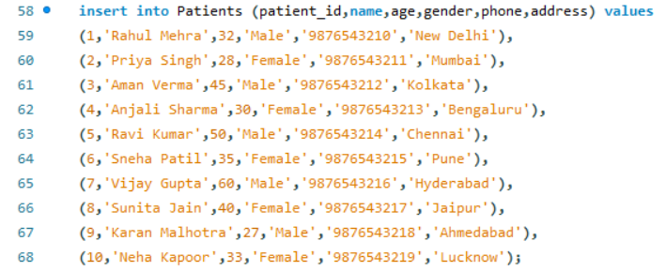

Slide 5
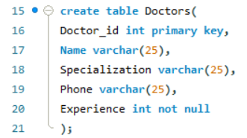
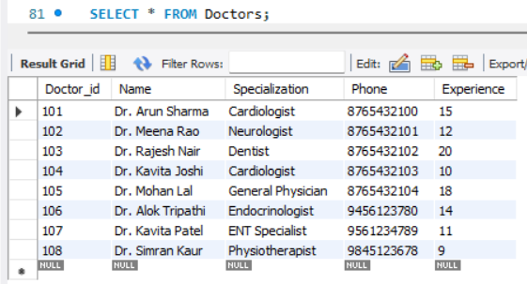
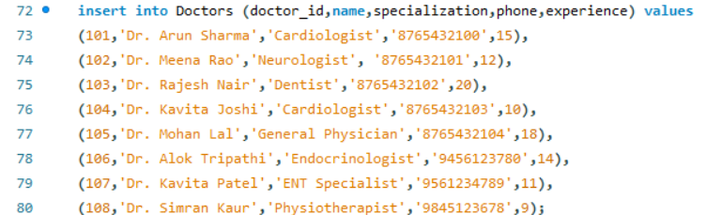

Slide 6
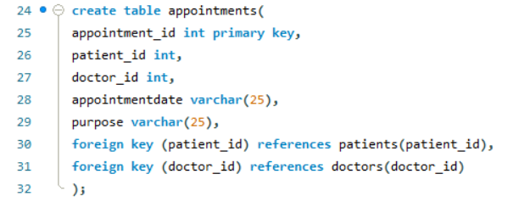
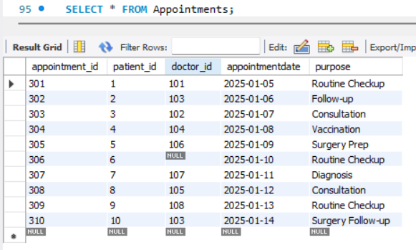
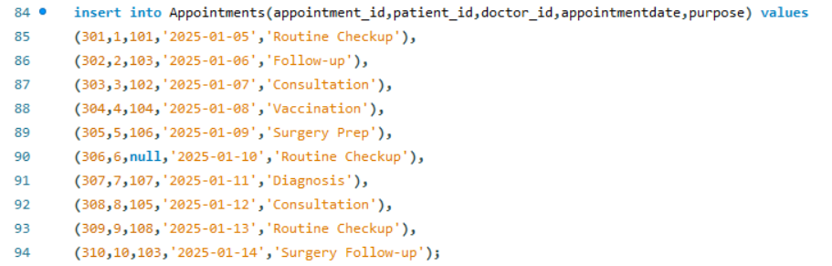

Slide 7
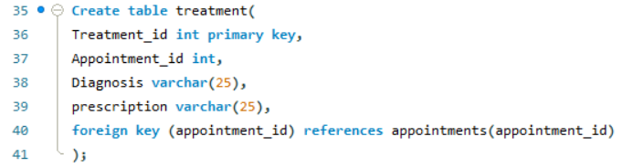
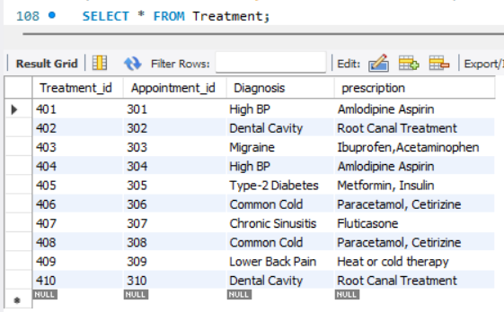
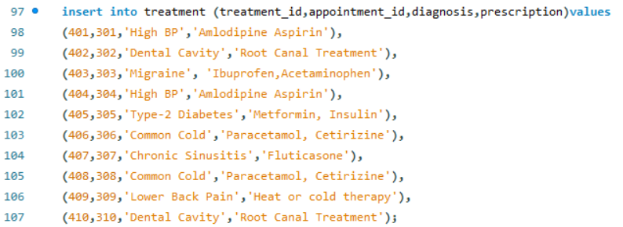

Slide 8
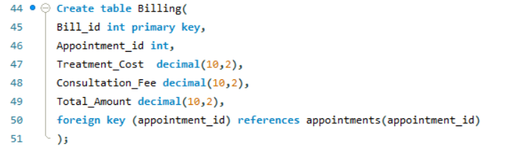
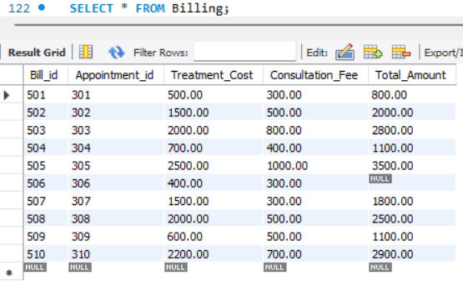
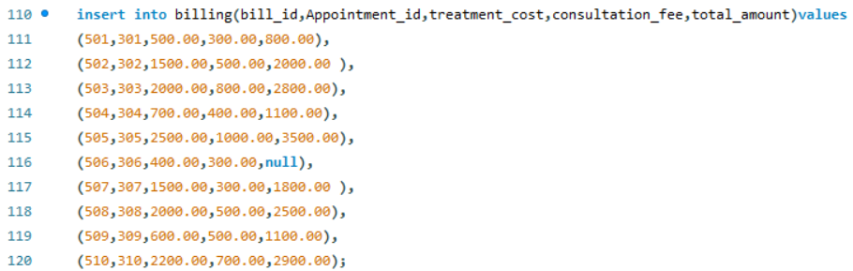

Slide 9
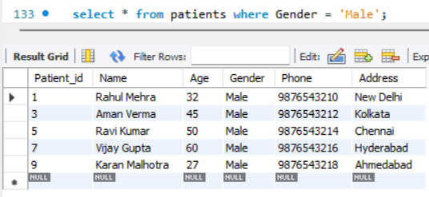
Find List of Male patients

Slide 10
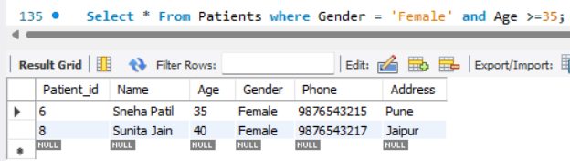
Find Female Patients whose age is greater than or equal to 35

Slide 11
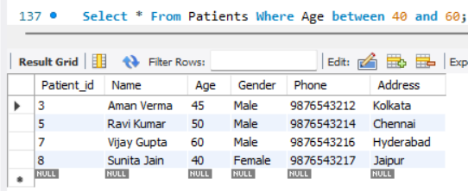
Find List of Patients whose age is between 40 and 60

Slide 12
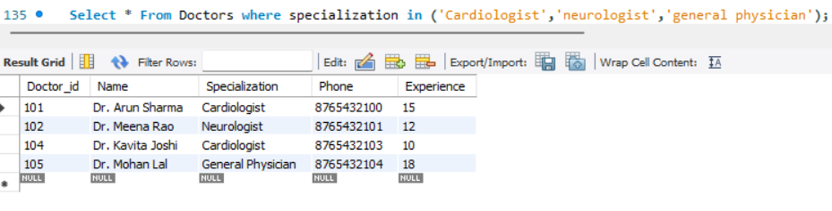
Find doctors who have specialization in Cardiologist, neurologist and general physician

Slide 13
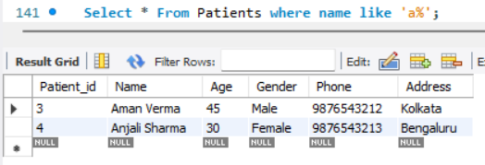
Find List of Patients where patient name start with ‘a%’

Slide 14
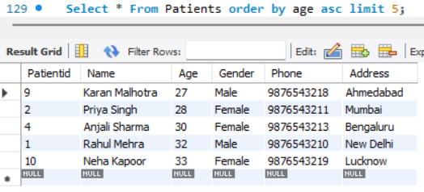
Find Top 5 youngest patients

Slide 15
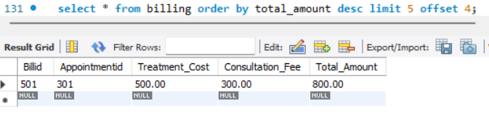
Find the lowest bill of patient

Slide 16
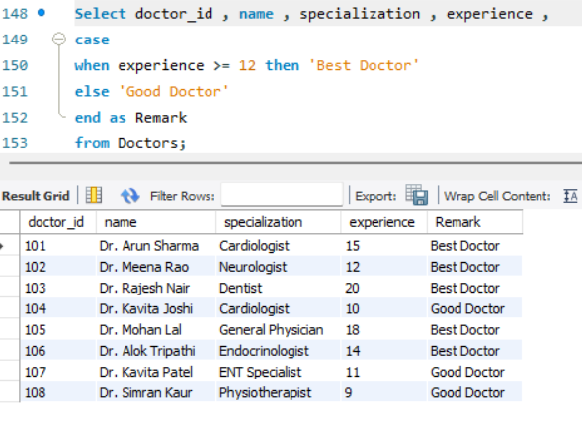
Which doctor is good or best according to experience

Slide 17
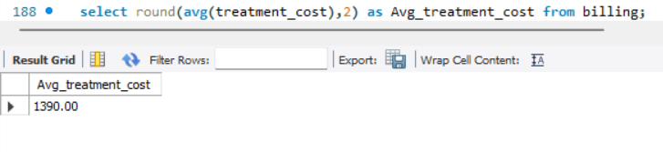
Find the average treatment cost

Slide 18
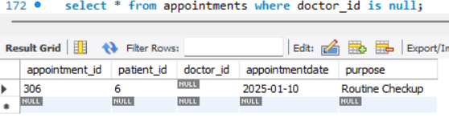
Find the null value of doctor id

Slide 19
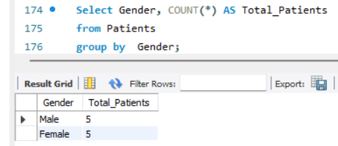
Find the total number of patients by gender

Slide 20
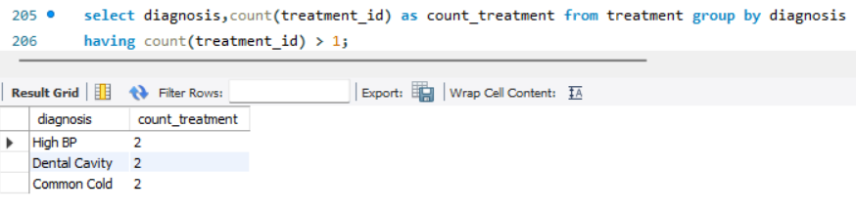
Find the diagnosis that have done more than 1 time.

Slide 21
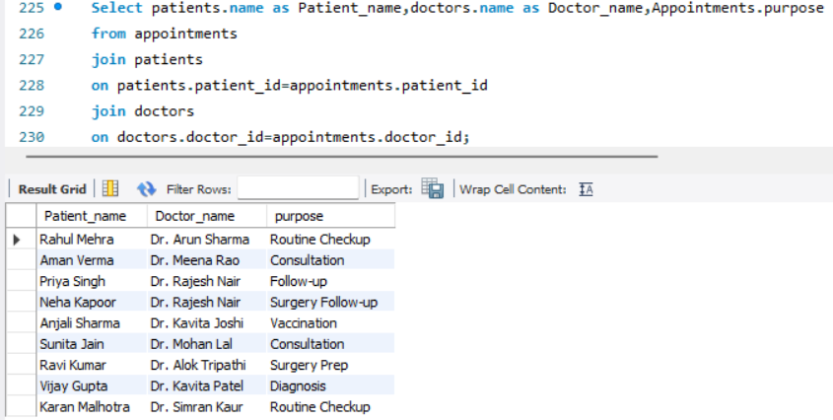
Find Patients name, doctors name and purpose of their appointments

Slide 22
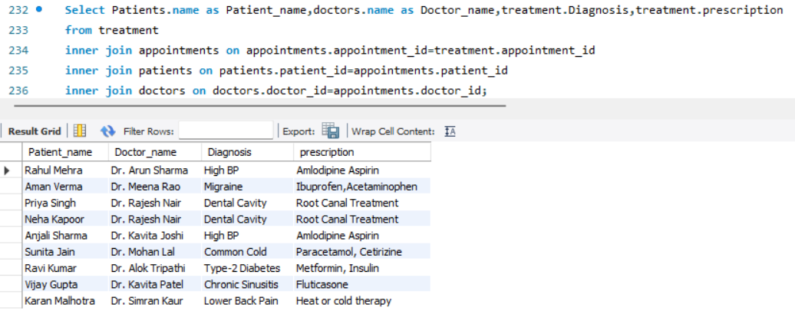
List all treatments along with patient and doctor name

Slide 23
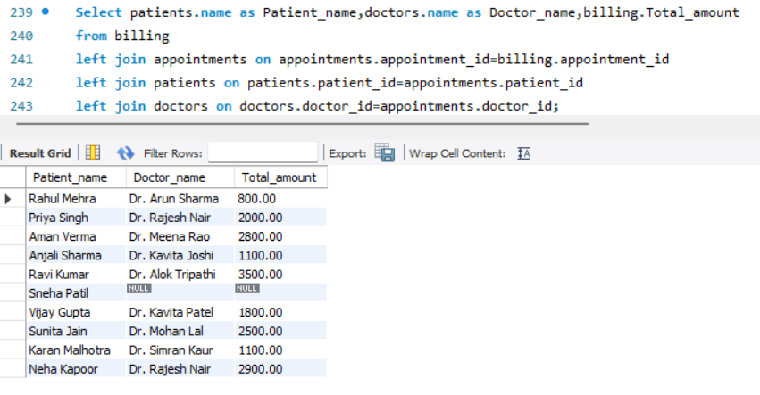
Find the billing details for each patient and their corresponding doctor

Slide 24
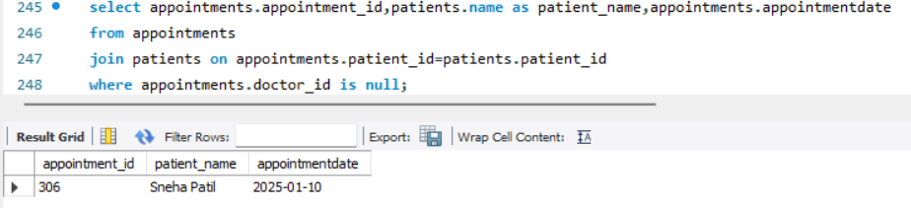
List all appointments that do not have a doctor assigned

Slide 25
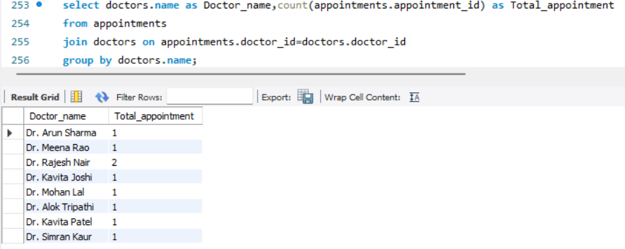
Calculate the total number of appointments handled by each doctor

Slide 26
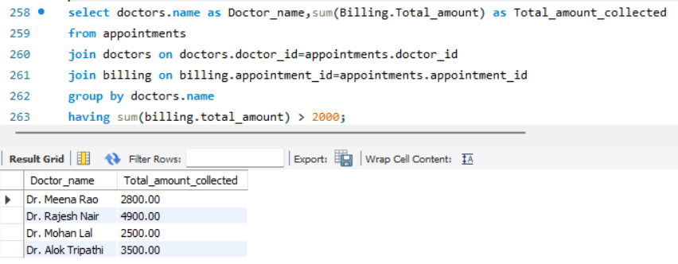
Find the Total amount collected by doctor is greater than 2000.

Slide 27
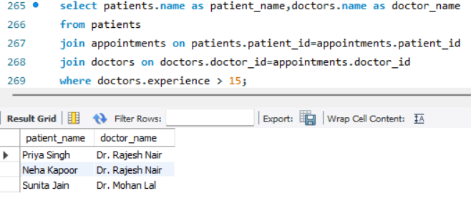
Find the patients who have appointments with doctor having more than 15 years of experience

Slide 28
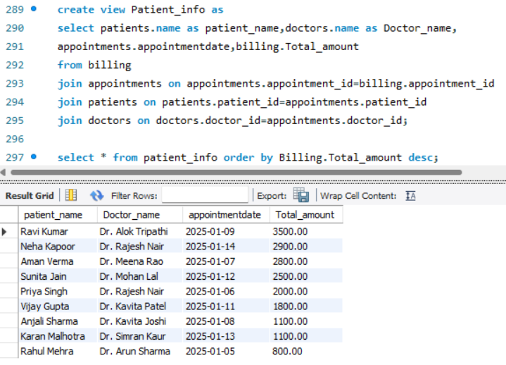
Find all patients along with their doctors, appointment dates, and total billing amount, sorted by total billing amount in descending order.

Slide 29
CONCLUSION
Hospital Management System is a modern healthcare facilities, enabling efficient and effective management.
Hospital Management System transforms the way healthcare services are delivered, making them more organized, cost-effective, and patient-focused.

Slide 30
Thank You

